Slide 1
Failure in Air Pressure System of Scania Trucks
rucks
Prediction of failure in APS of Scania Trucks

Slide 2
Objective
Development of a predictive model to predict whether a failure of a Scania Truck component is related to the air pressure system (APS) or not.
Benefits
This may help in avoiding failure during truck operation and thereby reducing maintenance cost.

Slide 3
Data Sharing Agreement :
  Sample file name :Scania Truck Failures
  Number of Columns: 171
  Column data type :170 numerical features and 1 categorical feature

Slide 4
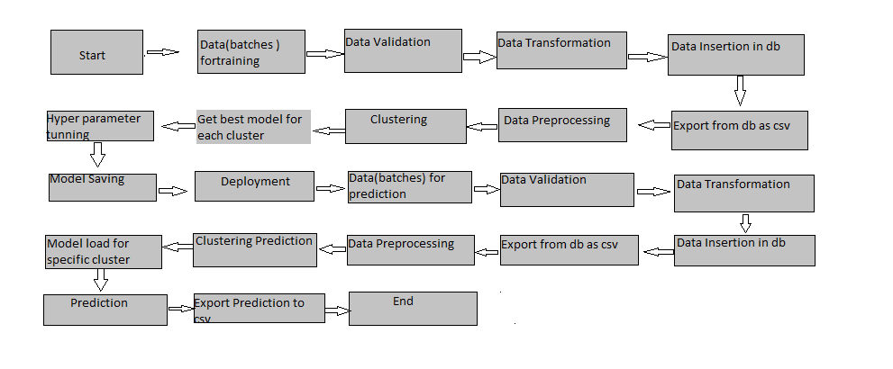
                Architecture

Slide 5
Data Validation and Data Transformation :
  Name Validation - Validation of files name as per the DSA. Created a regex pattern for validation. After it checks for date format and time format if these requirements are satisfied, will move such files to "Good_Data_Folder" else "Bad_Data_Folder.“
  Number of Columns – Validation of number of columns present in the files, and if it doesn't match then the file is moved to "Bad_Data_Folder.“
  Name of Columns - The name of the columns is validated and should be the same as given in the schema file. If not, then the file is moved to "Bad_Data_Folder".
  Data type of columns - The data type of columns is given in the schema file. It is validated when we insert the files into Database. If the datatype is wrong, then the file is moved to "Bad_Data_Folder".
  Null values in columns - If any of the columns in a file have all the values as NULL or missing, we discard such a file and move it to "Bad_Data_Folder”

Slide 6
Data Insertion in Database:
  Table creation :- Table name “sensor" is created in the database for inserting the files. If the table is already present then new files are inserted in the same table.
  Insertion of files in the table - All the files in the "Good_Data_Folder" are inserted in the above-created table. If any file has invalid data type in any of the columns, the file is not loaded in the table

Slide 7
Prediction:
  The testing files are shared in the batches and will perform the same Validation operations ,data transformation and data insertion on them.
    The accumulated data from database is exported in csv format for prediction
    Performed data pre-processing techniques on it.
    XGBoost model created during training is loaded and clusters for the preprocessed data is predicted
    Based on the cluster number respective model is loaded and is used to predict the data for that cluster.
    Once the prediction is done for all the clusters. The predictions are saved in csv format and shared.

Slide 8
Q1) What’s the source of data?
  The data for training is provided by the client in multiple batches and each batch contain multiple files
  Q 2) What was the type of data?
  The data was the combination of numerical and Categorical values.
  Q 3) What’s the complete flow you followed in this Project?
  Refer slide 5th for better Understanding
  Q 4) After the File validation what you do with incompatible file or files which didn’t pass the validation?
  Files like these are moved to the Achieve Folder and a list of these files has been
  shared with the client and the bad data folder was removed

Slide 9
Q 5) How logs are managed?
Different logs were used as per the steps that were followed in validation and
modeling like File validation log , Data Insertion ,Model Training log , prediction log
etc.
Q 6) What techniques were you using for data pre-processing?
  Removing unwanted attributes
  Visualizing relation of independent variables with each other and output variables
  Checking and changing Distribution of continuous values
  Removing outliers
  Cleaning data and imputing if null values are present.
  Converting categorical data into numeric values.
  Scaling the data

Slide 10
Q 7) How training was done or what models were used?
Before diving the data in training and validation set , clustering was performed over fit to divide the data into clusters.
As per cluster the training and validation data were divided.
The scaling was performed over training and validation data
Algorithms like Random Forest , XGBoost were used based on the recall final model was used for each cluster and that model was saved .
Q 8) How Prediction was done?
The testing files are shared by the client . Performed the same life cycle till the data is clustered .Then on the basis of cluster number model was loaded and prediction was performed. In the end we get the accumulated data of predictions.

Slide 11
Q 9) What are the different stages of deployment?
  When the model will be ready we deploy it in Fire environment .Where SIT and UAT is performed over it.
  Once We get Sign off from Fire we deploy in Earth and UAT is performed over it.
  After getting the sign off from Earth we deploy in production

